Slide 1
University of South Carolina Safety Training
29 June 2022
Fleet User Safety Session

Slide 2
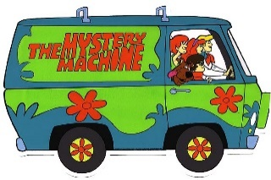



What’s the FUSS?
Fleet User Safety Session 2022
Van Car Truck Bus
USCA Operations Department
Brian Enter, Senior University Facilities Executive
Dominick Magliaro, Environmental Health & Safety Manager
Annette Beeler, Database Manager

Slide 3

Fleet User Safety Session
University Vehicle Policies
Drivers must obtain a 3 year Driving Record and complete a TS-100 form www.sc.edu/vmps/ts100.pdf
  Before driving a USCA owned or sponsored vehicle, all drivers must complete the individual Fleet User Safety Session prescriptive training (van, bus, truck or car).
  All Van drivers must be at least 21 years of age, have an acceptable driving record (<4pts no DUI), and successfully complete the training session (bus, car, truck drivers must be at least 18)
  Bring your Driver’s License and your Driving Record to training. You can get a copy of your record online from your state’s DMV website; SC www.scdmvonline.com
  Bus and Van drivers, without previous experience, must complete a driving familiarity exercise.

Slide 4
Fleet User Safety Session
University Vehicle Policies
Student drivers may drive USCA vehicles provided they also meet the following limitations:
  Students traveling in a university vehicle outside of the Aiken, Augusta, Columbia area must be accompanied by USCA faculty, staff or designated administration person. The name must appear on Form 13/20 USCA Vehicle Reservation Request.
  Students are not allowed to transport other students without USCA faculty, staff or other designated administration person. Exceptions to this provision are allowed at the discretion of the Chancellor or Vice Chancellor for Student Services.

Slide 5
Fleet User Safety Session
University Vehicle Policies
A university Wright Express card, proof of insurance, vehicle registration, and Auto Club membership card are provided in a packet on the sun visor of the vehicle, or glove box, & must NOT be removed from the vehicle.
Vehicles are not to be parked at a residence overnight.
Gas purchases for vehicles should be made with the WEX Card using your assigned PIN #. Receipts should include price per gallon, # of gallons, total cost. Your pin is assigned by the state of SC & will be mailed to you. Turn gas receipts into Annette along with your ‘Trip Ticket’
NO alcoholic beverages & NO smoking in vehicles - please
Posted speed limits must be followed, seat belts must be worn, & headlights must be on when driving.
Practice defensive driving techniques – avoid inattentive blindness (cell phone use and other distractions)
Copies of this policy handout are in the vehicle red folder, call Dom 641-3538 or Annette 641-3452 with any questions.

Slide 6
Fleet User Safety Session
Driver Responsibilities
Check vehicle prior to each use for visible signs of potential problems (tires, windows, seatbelts, leaks, lights, turn signals) Notify Operations if you have any problems with the vehicle
Adjust mirrors, seats, and other interior items
Before starting, secure your seat belt making sure others are buckled
Fill out Monthly Trip Log on clipboard
  Date / Name/ Odometer: In-Out / Travel: From-To / Job Function/ #Passengers
Check traffic flow (vehicles & pedestrians) before starting
Drive with lights on, obey all laws, regulations, and procedures
Exit vehicle only when engine is turned off & key removed
Refuel only when engine is turned off and key removed
Ensure vehicle is locked if it is to be left unattended
Promptly submit trip reports and gas receipts at the end of your trip
  Use Drop Box at SUPMT Bldg.
Check to see if gas tank is full before you start
Immediately notify USCA Police of any accident on campus

Slide 7
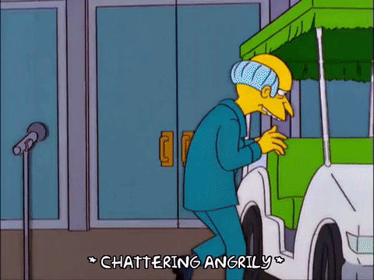
Fleet User Safety Session
Golf Carts
Golf cart operators must possess a valid driver’s license
Golf carts are to not be operate don roads where the posted speed limit is above 35mph
Golf carts may only be operated on campus
Use care when crossing the pedestrian bridge with a golf cart
Golf carts leaving main campus across the pedestrian bridge are to yield to carts coming from the Convocation Center
Do not carry passengers in cargo areas of carts, all passengers and operators must be seated in a cart seat, with no part of their body past the cart frame.

Slide 8
Fleet User Safety Session
15 Passenger Vans
Vans have a very high center of gravity and significantly increased risk for rollover accidents; unbalanced tire air pressure is a contributing factor and is checked
If van is not full, passengers should be seated in front of rear axle; do not transport more than 15 people (including driver)
Do not make sharp turns or over-corrections at high speed
Be especially cautious on curved rural roads & maintain a safe speed to avoid running off the road; If you drive off the road, slow down before returning to the road & accelerating
Because vans are substantially longer & wider more braking time & wide turns are required; abrupt maneuvers won’t work – the safe following distance should be at least 4 seconds
Children are not to be transported in 15 passenger vans
Be advised, 85% of people killed in rollover crashes were not wearing seat belts – don’t crash, but DO wear seat belts (the law)

Slide 9
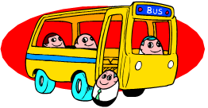
Fleet User Safety Session
BUS Door Procedures
BUS BACK DOOR SAFETY INTERLOCKS & ESCAPE WINDOW LEVER
(if the bus doesn’t start, or the alarm sounds, this is why)
UNLOCK the back door before attempting to start the engine. The “slide latch” lock is below the emergency handle and to the right of the door. To unlock: slide the latch all the way to the right, then lock the slide in place by rotating the slide lock down -then silence the alarm by pushing the silver button above door. (If alarm continues, you have not rotated the slide down to lock it in place).
Note: An alarm may or may not have sounded to remind you to unlock the back door. If it does sound, press the silver button above the door (after it is unlocked) to silence the alarm. You may now start the engine!
LOCK the back door after you turn off the engine to exit bus.
To lock: slide the latch all the way to the left. then lock the slide in place by rotating the slide lock down. Then silence the alarm.
Note: If an alarm sounds when you turn off the engine, it is to remind you to lock the back door before you exit. To lock it, slide the latch all the way to the left. After the door is locked, if alarm is sounding, press the silver button above the door, to silence the alarm. If you have any questions call 641-3452. You may now exit bus
EXIT WINDOW RED HANDLE LEVER MUST BE CLOSED
Note: If an alarm sounds or bus doesn’t start, it may also be to remind you to lock the exit window by closing the red lever.
When driving: unlock the back exit door.
When parked: lock the back door.

Slide 10
Fleet User Safety Session
Requesting a University Vehicle
Submit a USCA Vehicle Reservation Request available online through the Operations website – after asking Annette (3452) if the date is open
ALL vehicle reservation requests must be approved & on file with Operations prior to actual travel (preferably 2 weeks before)
Reservation times must be strictly followed (others have already reserved the vehicle after you)
If you have any questions, or need to make changes to arrival or departure times, call Annette at Operations 3452 as soon as possible
Often there are not enough vehicles to go around; try to plan ahead

Slide 11
Fleet User Safety Session
Picking Up a University Vehicle
University vehicles are located at Maintenance and Supply Building parking area, Parking Lot C (red-lined parking spaces for vans) or softball fenced area (for buses)
A vehicle Information/Key packet can be picked up at the Operations office (front desk) Monday – Friday from 8 a.m. to 5 p.m. It will have your name & vehicle number, a trip ticket for recording mileage in and mileage out, and keys.
Red Vehicle Information Packets are located in each vehicle. These packets include printed university policies and procedures for using the university WEX card, and the USCA AutoClub
Your vehicle comes with a full tank of gas. Do not fill the tank prior to return.

Slide 12
Fleet User Safety Session
Returning a University Vehicle
Vehicles must be returned to the same red-lined parking area after use.
Please return the Key Packet (containing keys & trip ticket) to the Department of Operations using the Drop Box. Please do not leave belongings, debris, or keys in the vehicles when returning them (a big problem here – help us out)
If returning a vehicle after hours, use the large black key drop box located at the sidewalk gate entrance to the SUPMT courtyard.
If you had a minor accident (dent, scrape etc.) or operating problem (brake lights, wipers etc.) PLEASE notify Operations so they can fix the vehicle for the next person.

Slide 13
Fleet User Safety Session
Paragon autoclub coverage:
Battery Service - Jump-start provided. If unable to be started, it will be towed to the nearest service facility.
Flat Tire Assistance - An inflated spare will be installed to replace a flat tire.
Vehicle Fluid Delivery - Gas or other fluids delivered to you
Mechanical Adjustments - Minor adjustments will be made. If unsuccessful, it will be towed to the nearest facility.
Lock-Out Service - When keys are locked inside the vehicle.
Towing/Extricating - If disabled due to a breakdown or other covered disablement, towing/extricating is provided with delivery to the nearest service facility.
VIP Services – Additional benefits in case of a breakdown
  Travel assistance – airline or car rental assistance
  Hotel/motel reservations – for overnight accommodations
  Personal assistance- to notify others of your delay & assist with your safety

Slide 14
Fleet User Safety Session
How to Use the Auto club Program…
Call the dispatch service 24/7 at 1-888-597-2863
Be prepared to give the following information:
  Membership number #10578-A55172
  Location of disabled vehicle or lockout (city, state, and closest intersection or landmark.)
  Year, make, model, and color of the vehicle.
  License number and state of registration.
  Type of service needed: tow, tire change, battery boost, locksmith
  Phone number you are calling from.
Present your card to the service provider
Operations will help you file any claims for reimbursement using original itemized receipts

Slide 15
Fleet User Safety Session
Accident Reporting Procedures
Turn vehicle ignition off and evacuate vehicle, then call for medical assistance or ambulance. Render first aid to injured persons, as you feel comfortable.
For accidents occurring on campus, call USCA Police 6111 or 648-4011 from a cell phone. For accidents occurring off-campus call 911 and then call to report the accident to Operations 641-3452 during normal business hours. If after hours, then report the accident to USCA Police.
DO NOT ADMIT RESPONSIBILITY OR LIABILITY FOR ANY ACCIDENT.
Give other driver your name and USCA address only
  471 University Parkway; Aiken SC 29801

Slide 16
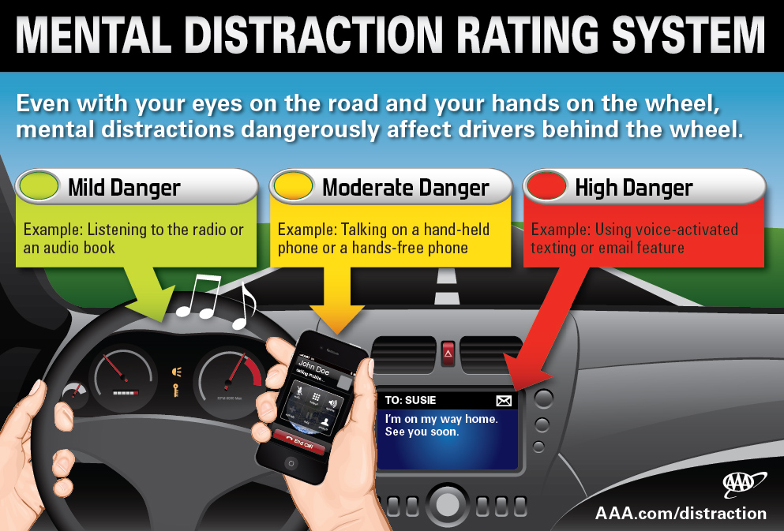
Fleet User Safety Session
Distracted Driving

Slide 17
Fleet User Safety Session
Conclusion
Drive Safe - If you have any questions or concerns:
Call Dom at 3538 Dominick.Magliaro @usca.edu or Annette 3452

