Slide 1

University Purchasing Card
General Guidelines

Slide 2
This session will cover the parameters of the Purchasing Card program to include:
    Limits of the card
    Cardholder responsibilities
    Lost/stolen or compromised cards
    Monthly cardholder duties
    & will touch on Liaison responsibilities

Slide 3
The University of South Carolina Purchasing Card (P-card) program is a charge card designed to enable authorized full-time permanent employees of the State of South Carolina to make small value purchases of supplies, materials, equipment, and services for State business use. The program streamlines payments by eliminating the administrative burdens and costs associated with traditional methods of payment.
The P-Card may only be used for official State business and must be surrendered upon termination of employment or upon demand by the State or by the cardholder’s employer.
State employees expending public monies hold a public trust; their conduct must meet the highest ethical standards.
University of South Carolina is not tax exempt and must pay sales tax to the supplier or use tax to the South Carolina Department of Revenue on all tangible items purchased.

Slide 4
Purchasing Card Solicitation and Outreach
Use of the P-Card is subject to the small purchase procedures established by the State Consolidated Procurement Code (Code), this policy and Agency purchasing policies and procedures.
Continue to use goods and services statewide contracts such as:
  Office supplies, educational supplies, building and grounds supplies, medical supplies, scientific supplies, etc.
Continue to use information technology statewide contracts such as:
  Computers, laptops, tables, toner cartridges, cellular services/equipment, audio visual products and services
Attempt to solicit and support local, small, and minority businesses
  Seek opportunities to procure quality goods and services
  Encourage acceptance of the procurement card for quicker payment
  Monies remain local in our own communities

Slide 5
    Limitations of Purchasing Cards Spending
    P-Card Purchases $10,000 and under may be made without securing competitive quotations or any type of value analysis if the prices are considered fair and reasonable.
    Monthly spending limits are set at $10,000 per cycle. The cycle for USC Aiken is the 28th day of each month to the 27^{th day} of each month. At that time the $10,000 limit will be reset.
    Single Transaction Limits is set to $4,999.99. This limit shall include the merchandise, shipping, and taxes.
    Merchants may not exceed the Single Transaction Limit (STL) or split the purchase in order to accommodate for the STL

Slide 6
Use of the Purchasing Card
The P-Card has the Cardholder’s name embossed on it, and in accordance with VISA International regulations and State policy, may only be used by that individual.
Use of the P-Card by a person other than the Cardholder are unauthorized and strictly forbidden.
Use of the P-Card by a person other than the Cardholder may result in disciplinary action, up to and including termination from State employment and criminal prosecution.
Splitting transactions to avoid the single transaction limit is strictly prohibited and doing so may result in removal of P-Card privileges.
Purchasing activities include obligations for proper transaction documentation, fiscal responsibility, ethical behavior, adherence to federal and state government regulations, and compliance with university by-laws and policies.
All items purchased with the purchasing card shall be shipped to 650 Trolley Line Road, Graniteville, SC 29829. No deliveries shall be sent to home or personal addresses.

Slide 7
Prohibited Purchases
Personal purchases of any kind (Personal purchases are defined as purchases of goods or services intended for non-work-related use or use other than official State business).
Use of the P-Card to obtain cash advances or withdrawals is strictly forbidden.
Gift cards, stored value cards, calling cards, pre-paid cards or similar products.
  NOTE: Gift Cards received as promotional items are to be used to the benefit of the State. If an employee receives a gift card, the card(s) must be turned in to the Agency P-Card Administrator.
Employee travel expenses, including lodging, transportation, and meals.
Entertainment, including in-room movies.
Alcoholic beverages.
Tobacco products.
Purchases using a P-Card from a vendor with a blocked MCC.

Slide 8

What can I buy or what can’t I buy?
Food and food items (napkins, plates, utensils, food wraps, cooler, microwave, etc.), Plants, Flowers, Gifts/Giveaways, Stamps, Gift Cards, Clothing, Personnel Consumption Items (Kleenex, hand sanitizer, first-aid supplies, air freshener, etc.), Rentals, Greeting Cards, Registration Fees if associated with travel or meals, All student registrations, Tickets for any type of entertainment, Dry Cleaning
May not receive promotional supplies or incentives
If purchase is in question, please contact your liaison
Memberships, Subscriptions, General Office Supplies, Services, programmatic supplies
Mandated to purchase any items from State Contracts

Slide 9
Cardholder Responsibilities
Maintain security of the account number, expiration date, and security code at all times.
Maintain knowledge of State P-Card Policy and internal policies and procedures.
Ensure all purchases are allowable purchases according to State and internal P- Card policies.
Ensure all purchases comply with purchasing requirements of the SC Procurement Code.
Ensure that funds are available prior to making any purchase.
Obtaining “best value” for the State when making purchases with the P-Card.
Consolidated Procurement Code compliance is required for each acquisition.
Items offered by State Term Contract, (ie, furniture, lab supplies, toner, office supplies, etc.) must be purchased from the supplier awarded the contract.
Purchases from open market sources shall be distributed equitably among qualified suppliers.

Slide 10
The approver(s) are responsible for auditing the expense report and verifying those expose reposts represents the attached statement, includes attached receipts and backup and is allocated to the correct account distribution.
  By checking this box, I certify the Procurement Card transactions included on this expense report are accurate and have been reconciled to the card statement. The transactions also meet USC Purchasing Policy and include the appropriate backup and justification.
  Timely electronic approval by the cardholder, liaison, and department head is required. All expense reports must be submitted and approved prior to the next cycle of statements are released.
  Department heads are fully responsible for all activity. The Department Chair/Head Certification Statement signed prior to designative this role reads:
    To the best of my knowledge, these statements are accurate. All statements have been inspected and approve by me, with statements as well as the supporting receipts attached to the expense reports. I am responsible for in my department.

Slide 11
What do you do if you erroneously charge a personal item on your p-card?
  Return merchandise to store for a credit on your purchasing card.
  Reimburse the university. Attach the deposit receipt along with a written explanation referencing preventive measures, and corrective action taken to your expense report.
Why would my p-card be declined?
What is I cannot locate my receipt?
  If receipt has been lost and a duplicate cannot be obtained, the P-Card Administrator can determine if internal policy will allow use of a Lost Receipt Affidavit. If allowed, a single Cardholder can use the form no more than three times in one fiscal year.
  Use of the affidavit more than three times in one fiscal year will result in suspension of card privileges.
Can I split a transaction to circumvent the purchase limitations?
Can I return “stuff”?

Slide 12
Activation of Purchasing Card
The standard card Bank of America issues utilizes Chip and Pin technology, which is a card that contains data embedded in a microchip and requires the consumer to enter a personal identification number to complete the transaction.
The personal identification is your USC ID. This ID is the indicated with a beginning letter. You will enter the corresponding number from your phone keypad. Example – USC ID A12345678 you would enter 212345678.
Card activation will also require entry of your own unique PIN.
Your card should arrive approximately 10 – 15 days from training.

Slide 13

P-card is good for 5 years
Upon expiration all cardholders will be
required to take a refresher exam (Questions
come directly from policies and procedures
Test will be administered through Blackboard
If cardholder fails the test they will be required
to sit for training again and retake the test

Slide 14
Setting email preferences in PeopleSoft

Slide 15
Using PeopleSoft to create monthly expense reports
Update your PeopleSoft email address to your @usca.edu email address.
Obtain monthly bank statement from BOA payment center website. Instructions will be forwarded as how to register your purchasing card.
Have available all receipts in pdf format to upload to transactions in My Wallet and along with a pdf of your monthly bank statement.
Receipts must be detailed as to what was purchased, shipping, and sales tax.
Procurement transactions (charges) are interfaced from Bank of America into PeopleSoft My Wallet.
Cardholders are responsible for reviewing and updating each of card charge before they are consolidated into the Expense Report statement. The following is required for each card transaction:
a. Entering a justification and description for each transaction.
b. Reviewing and updating the use tax applicability.
c. Attaching the receipt to the transaction.
d. Attaching the bank statement to the expense report.
Using My Wallet Video (YouTube 7-minute video)
Creating An Expense Report Video (YouTube 11-minute video)

Slide 16
AMAZON BUSINESS
Program went live with initial wave of account invitations issued March 3, 2020.
Eligible users are full-time employees with a valid procurement card issued by Bank of America and authorized by Purchasing.
New users must complete the Terms of Use agreement to be invited to activate an account. The agreement will be sent to purchasing@sc.edu.
All policies and restrictions related to the p-card apply to the use of Amazon Business.

Slide 17
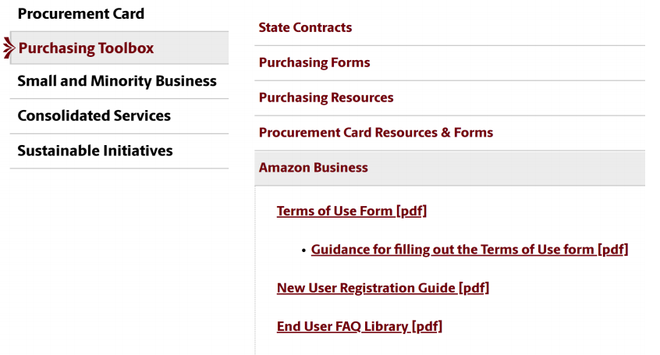
AMAZON BUSINESS
https://sc.edu/about/offices_and_divisions/purchasing/toolbox/index.php

Slide 18

QUESTIONS

