Slide 1
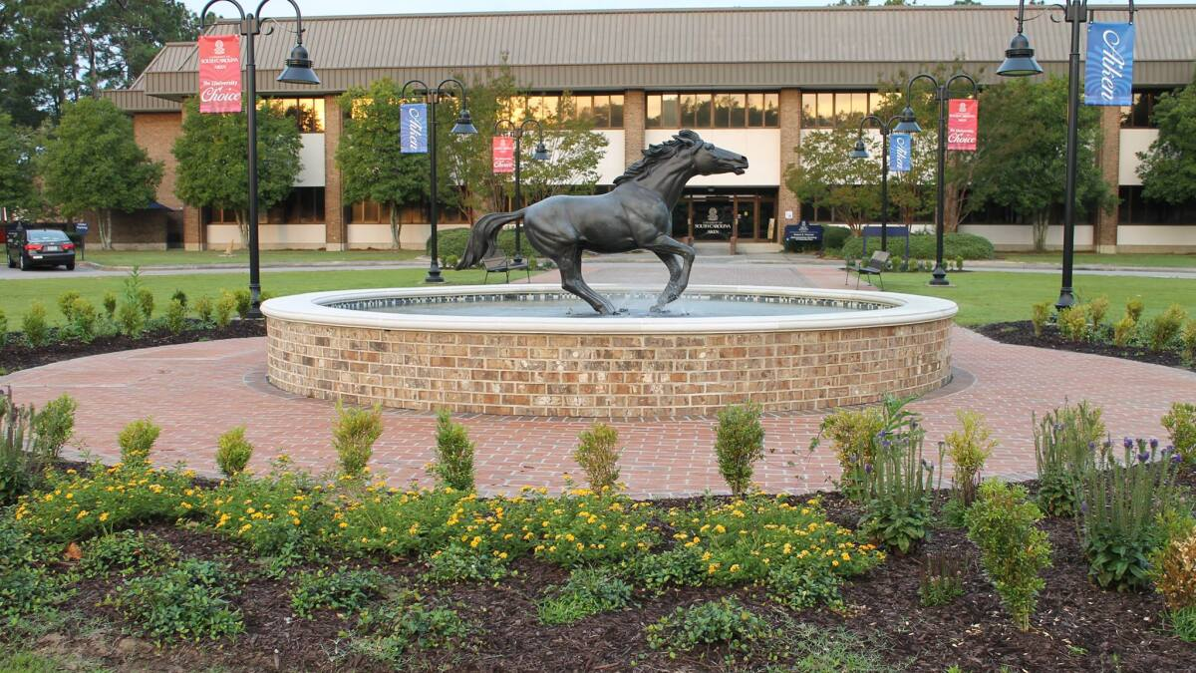

USC Aiken
IACUC

Slide 2
What is an IACUC?
I Institutional
A Animal
C Care
U Use
C Committee
IACUC stands for Institutional Animal Care and Use Committee. IACUC is a standing committee mandated by Federal law to provide oversight at institutions using animals in research, teaching, or testing, in order to ensure the humane and ethical treatment of animals.

Slide 3
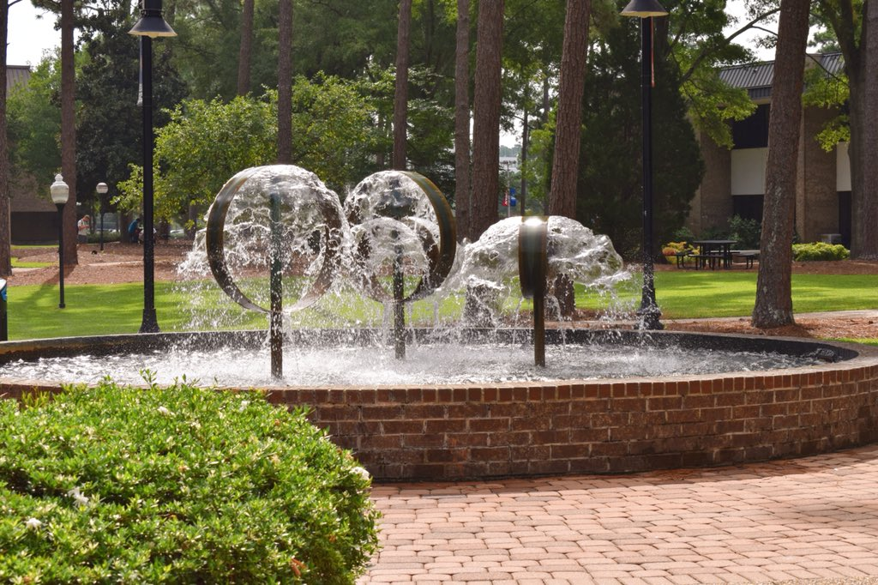
Chancellor
Daniel Heimmerman
At USC Aiken, the lines of authority and responsibility for administering the program and ensuring compliance are:
Provost
Daren Timmons
Institutional Official
C. Nathan Hancock
Consulting
Veterinarian
Dr. Lisa James
IACUC Committee
Animal Facility Management

Slide 4
Our Mission
A commitment to appropriate and humane animal care and use;
Procedures for reviewing and monitoring the care and proposed or ongoing use of animals;
Mechanisms for suspending questionable procedures or projects;
A satisfactory veterinary care program, including a description of the provisions for emergency, after-hours care, and how an investigator would obtain such care;
Training and Occupational Health Program for persons working with animals, including requirements pertaining to the use of personal protective equipment and personal hygiene procedures;
Policies pertaining to the use of hazardous agents in laboratory animals, long-term restraint, or multiple surgical procedures.

Slide 5
Membership
The Committee will consist of a minimum of five (5) and a maximum of eleven (11) voting members to include:
Chair
Vice Chair (optional)
Attending Veterinarian (AV)
At least one practicing scientist experienced in animal research
At least one individual having no affiliation with the University (other than as a member of the IACUC) and no immediate family member affiliated with the university
At least one individual whose primary concern is non-scientific in nature

Slide 6
Committee members are expected to exhibit high ethical standards of conduct and to:
Carefully review all IACUC documents and materials in a timely manner
Regularly attend and participate in meetings, facility inspections, and program reviews
Serve as primary or secondary reviewers for scheduled reviews or any time regulatory or welfare standards are not being met
Maintain appropriate confidentiality
Perform duties as assigned by the Chair

Slide 7
Federal Guidelines
We operate under the University of South Carolina Aiken’s Animal Welfare Assurance for Domestic Institutions.
We review the institutional program for humane care and use of animals using the Guide for the Care and Use of Laboratory Animals.
We follow all applicable provisions of the Animal Welfare Act; the U.S. Government Principles for the Utilization and Care of Vertebrate Animals Used in Testing, Research, and Training; Public Health Service (PHS) Policy on Humane Care and Use of Laboratory Animals; and other Federal statutes and regulations relating to animals.

Slide 8
Responsibilities
Inspect all institutional animal facilities using the Guide as a basis for evaluation at least once every six (6) months.
Review and approve, require modifications, or withhold approval of activities related to the care and use of animals at USC Aiken according to PHS Policy IV.C.1-3.
Prepare and submit semiannual and annual IACUC reports.

Slide 9
Training
USC Aiken has adopted the Collaborative Institutional Training Initiative (CITI) and AALAS Learning Library online training program to provide the required education to animal care and use personnel. Individuals will be required to complete the modules assigned to their learner group (role) in the animal care program:
  Investigators, staff and students that perform lab animal research must take the “Working with the IACUC” course.
  IACUC institutional officer, chair, members and coordinators must take two courses: “Working with the IACUC” and “Essentials for IACUC Members.”
  Investigators who are conducting field or observational studies must complete the “Wildlife Training” module.

Slide 10
Training, continued
Protocol-specific training modules and/or species-specific training modules can be assigned.
Additional training will be required if a protocol involves procedures such as survival surgery, monitoring post-surgery pain, animal restraint, collecting blood, or other special considerations.
Principal Investigators, Co-Investigators, and key research personnel must complete a continuing education requirement every 3 years.

Slide 11
Protocols
All users (including pilot studies) are required to submit an Animal Use Protocol form (https://www.usca.edu/academic-affairs/faculty-resources/iacuc/forms ) prior to starting experimental use of animals.
Animal Use Protocols (AUPs) are approved for up to a three-year period. Projects that continue past the three-year period require a new AUP.

Slide 12
Protocols, continued
Changes to approved protocols are accomplished through the submission of an amendment.
The PI can add or remove researchers working on a protocol by submitting an updated personnel sheet to the IACUC chair. Any new personnel must be properly trained and fulfilled the Occupational Health and Safety requirements before starting on a project.

Slide 13
Types of Reviews
Full Committee Review (FCR)
All new proposals require a FCR.
Designated Member Review (DMR)
Submissions that do not require a Full Committee Review may be assigned to a DMR.
The IACUC Chair will appoint two IACUC members (selected on a rotating basis) to serve on the DMR, and may include the IACUC Veterinarian when animal care concerns may be involved.

Slide 14
Voting
With the exception of Designated Member Reviews, approval on any motions or actions of the Committee may be granted only at a convened meeting of a quorum of the IACUC and with the approval vote of a majority of the quorum present.
All votes will be tallied and recorded in the meeting minutes as: For, Against, or Abstaining.

Slide 15
Inspections
IACUC members will inspect animal facilities, using the Guide as a basis for evaluation, at least once every six months (+/- 30 days) during the Spring and Fall IACUC meetings using a checklist provided by the National Institutes of Health Office of Laboratory Animal Welfare (OLAW).
In addition to the semi-annual scheduled inspections, the veterinarian and the IACUC can perform additional facility inspections of all rooms in which animals are housed.

Slide 16
The checklist provided by the OLAW allows the inspection of:
Location: animal areas, separation of species, separation by disease status;
Construction: corridors, doors, windows, floors, drainage, walls, ceilings, HVAC, power, lighting, noise;
Room/Cage: temperature, humidity, ventilation, illumination, noise control;
Cage/Run: sanitation, cleaning tools, food/water access, security, safety, allows undisturbed observation, size, rationale for Guide/USDA exceptions, meets physiologic, behavioral, social needs;
Behavioral Management: environmental enrichment, social grouping, animal activity;
Food: feeding schedule and procedures, contamination, vendor quality control, storage in sealed containers, expiration date labeling, vermin control, rotation of stocks;
Water: ad libitum unless justified;
Sanitation: Appropriateness of bedding frequency of bedding change, cleaning, disinfection, monitoring;
Waste Disposal: procedures for collection, storage and disposal; hazardous waste; animal carcasses;
Pest Control: regularly scheduled, documented program including control of rodent pests and insecticide use;
Emergency, Weekend and Holiday Animal Care: provision for accessible contact information, monitoring of backup systems, veterinary care, a disaster plan that takes into account both personnel and animals;
Animal Identification and Records: cage/rack cards contain required information, clinical records accessible and appropriate;
Storage: food and bedding, supplies, drugs and biologics, waste material, hazardous material, carcasses.

Slide 17
Deficiencies
Deficiencies noted will be distinguished as minor (not directly affecting animal health or safety) or significant (directly affecting animal health or safety).
In consultation with the IACUC Chair and veterinarian, the IACUC will create a reasonable plan and schedule for correcting each deficiency.
In extreme cases, the Consulting Veterinarian may temporarily halt or cease activity until a majority of the IACUC can convene to consider full suspension of the activity.

Slide 18
Annual Reports
The Institutional reporting period follows the federal fiscal year (October 1 – September 30).
The Chair will prepare an annual report according to the requirements of the PHS Policy at least once every 12 months.
This report will be reviewed by the Committee and submitted to the Institutional Official (IO) for signature.
The IO will submit the report to OLAW.

Slide 19
Recommended Videos
Can we do science without animal testing? (3:41)
https://www.youtube.com/watch?v=2hxUMpYFo_Y
Touring an animal research facility (4:02)
https://www.youtube.com/watch?v=SGy1QHPyvtM
Animal welfare and scientific quality depend on the 3Rs (6:38)
https://www.youtube.com/watch?v=yUoFq0Xlpvg

Slide 20
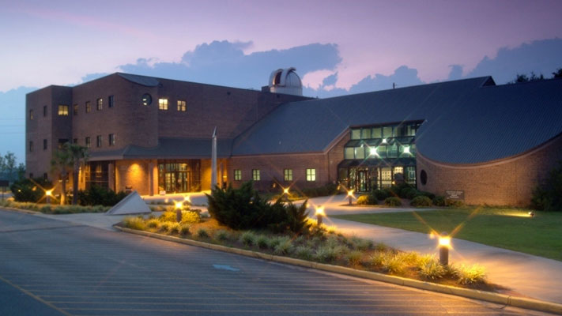
Thank you for your commitment to help ensure the humane and ethical treatment of animals on our campus.

